Slide 1


SOFTWARE PRESENTATIOOOOOOOOOON
By Ari

Slide 2

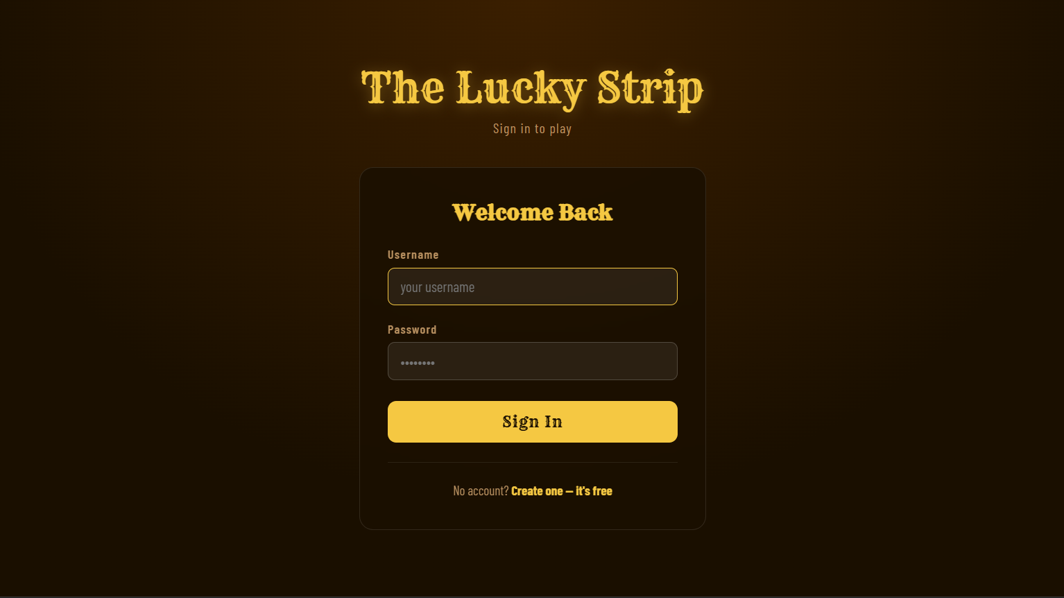
Sign in page

Slide 3


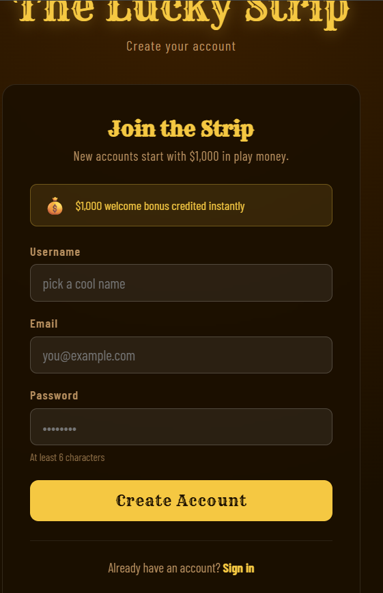
Sign Up page

Slide 4
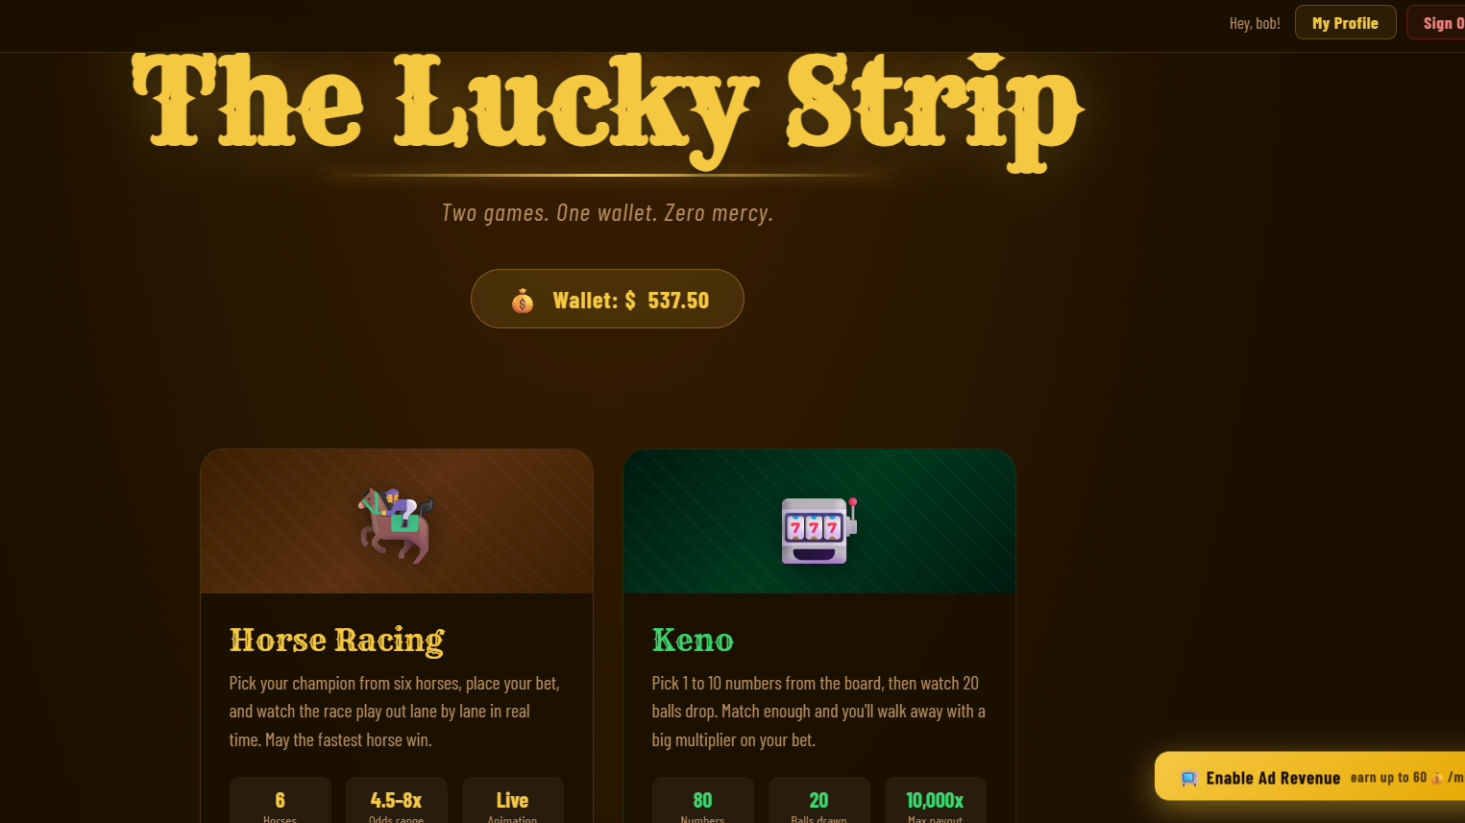
Home page

Slide 5

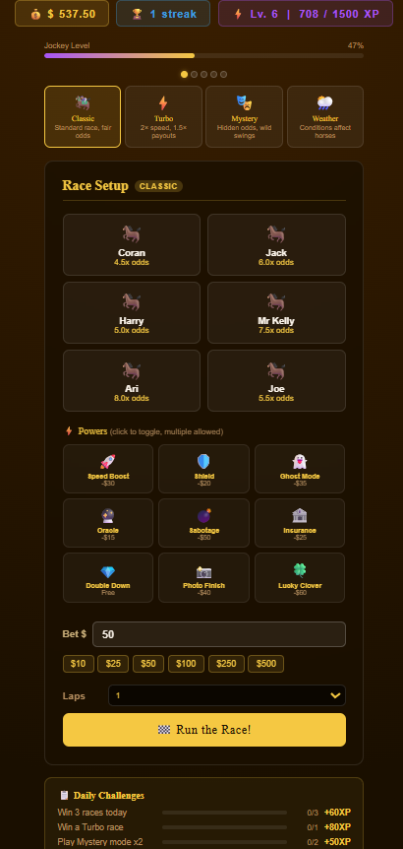
Horse racing

Slide 6
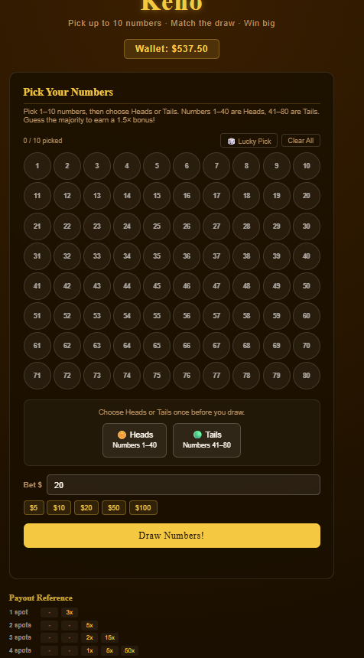
Keno

Slide 7
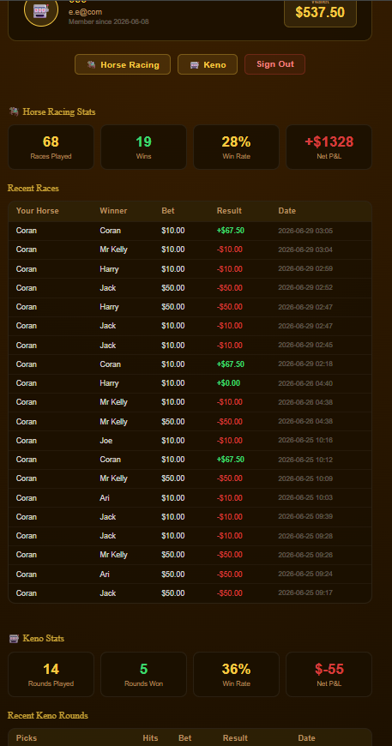
Profile

Slide 8
Thanks for listening
Little bonus thanks

